Slide 1


UK NEQAS- in a nutshell
EQA
Shila Seaton
Bacteriology/ Mycology and Special Surveys Scheme Manager
UKNEQAS for Microbiology
June 2022

Slide 2
Quality Assurance
QA is the total process whereby the quality of laboratory results can be guaranteed.
The reliability of results is improved by undertaking QA therefore minimising the variability of results.
The variability may arise from biological or analytical sources,
-fundamental in all qualitative and quantitative investigations

Slide 3

Certification of the laboratory
EQA
Standard operating procedures
IQA
ISO 15189
Quality assurance
system
IQC
Instrument calibration & maintenance
ISO 17043
ISO 17025
Education / Competency/
training of staff
Reagents /material certification
Documentation/Record keeping / Audits

Slide 4
Internal quality control (IQC)
IQC is carried out continuously within the laboratory to ensure the systems are performing to pre-defined specifications.
Assesses and monitors test performance in real time to ensure consistent performance and reproducible results.
Process monitors or measures reproducibility, but not necessarily the accuracy.
Majority of these procedures involve the analysis of the control material or international standards (where available), and compares this to the accepted levels predetermined at the validation stage of the test procedure.
Notes:
4

Slide 5
Internal quality assessment (IQA)
Clinical specimens are anonymously re-introduced back through the diagnostic laboratory process.
Ensures the processes are:
                operating at an acceptable level
          monitors performance of staff and
          monitors consistency of test procedures

Slide 6
External quality assessment (EQA)
Provide inter-laboratory comparability, standardisation of diagnostic testing and fundamentally as an educational tool.
Allows comparison of a laboratory’s competence in testing, to an external source.
A system for objectively checking the laboratory’s performance using an external provider.
Notes:
6

Slide 7
Types of EQA
1. Proficiency testing external provider sends unknown samples for testing to registered participating laboratories, and the results of all the laboratories are analysed, compared and reported to the laboratories.
2. Retesting slides that have been read previously are rechecked by a reference laboratory; samples that have been analysed are retested, allowing for inter-laboratory comparison.
3. On-site evaluation is usually carried when it is difficult to conduct traditional proficiency testing or to use the rechecking/retesting method.
4. Inter-laboratory comparison is the exchange of samples among a set of laboratories (round robin testing) for when no proficiency testing is available

Slide 8
UK National External Quality Assessment Service
UK NEQAS comprises a network of >400 EQA programmes
Operating from >20 centres
  Based at major hospitals, research institutions and universities
Aim: to improve patient care
  Through monitoring the quality of testing & reporting

Slide 9
UK NEQAS Divisions website: ukneqas.org.uk
Clinical Chemistry | blood chemical components: cardiac markers, drug assays, peptide hormones, trace elements
Genomics and reproductive Science | cytogenetics and molecular genetic analysis
Haematology | blood cellular components, blood grouping, blood coagulation, haematinics, feto-maternal haemorrhage, leucocyte Immunophenotyping
Cellular pathology | structure and function of body tissues
Immunology and immunocytochemistry | components of the immune system in blood, histocompatibility and immunogenetics
Microbiology | Infectious microbiological agents, parasites & antibiotics/antifungal assays

Slide 10

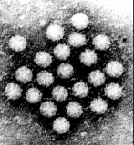

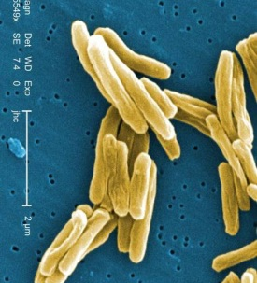

Schemes overview
Identification
Biochemistry
Antigen (IF / agglutination)
Growth characteristics
Molecular
Virology/ Molecular
25 schemes
Typing / subtyping
Biochemistry
Antigen
Molecular
Mycology
5 schemes
53 SCHEMES
Quantification
Microscopic
Molecular
Bacteriology
12 schemes
Susceptibility
Phenotype
Genotype
Parasitology
9 schemes
Serology
EIA
Agglutination
Line assays
IF
Notes:
10

Slide 11
Microbiology Schemes
Bacteriology | Molecular detection of mycobacteria | Measles and Mumps IgG serology
AAFB microscopy | Molecular detection of HPV | Parvovirus B19 and Rubella serology
Antimicrobial Susceptibility | Molecular detection of respiratory viruses | Respiratory Rapid - RSV
Clostridiodes difficile* | Molecular detection of viruses in CSF | Rubella IgG serology
Community Medicine |  | Virus identification
Faecal pathogens | Mycology | SARS-CoV 2
General bacteriology | Antifungal susceptibility | Parasitology
Genital pathogens | Fungal biomarkers galactomannan/glycoprotein | Blood parasitology
MRSA screening* | Mycology (culture) | Faecal parasitology
Mycobacterium culture | Teaching Scheme - Mycology | Malaria rapid
Syphilis serology | Cryptococcal antigen detection | Molecular detection of Malaria
Urinary antigens | Virology | Parasite serology
 | Anti-HBs detection | Toxoplasma serology
Molecular* | Blood Borne Virus | Teaching Scheme - Faecal Parasitology
C. trachomatis and N. gonorrhoeae | Diagnostic serology (hepatitis screen) | Teaching Scheme - Blood Parasitology
CMV DNA quantification | Hepatitis B serology
EBV DNA quantification | Hepatitis C serology | Clinical Interpretation
HBV DNA quantification | HIV point of care testing | Interpretative comments
Hepatitis C RNA detection | HIV serology
HIV1 RNA quantification | Immunity screen

Slide 12
The Philosophy of UK NEQAS for Microbiology
Schemes are educational they are not designed to be punitive or for use in the licensing of laboratories.
Specimens are predominantly straightforward
Specimens will mostly reflect what participants are likely to find in routine specimens in their laboratories
Occasionally, a more difficult or unusual specimen may be included in order to give participants the opportunity to gain experience.
Objective of the schemes is to allow participants the opportunity to learn from failures.

Slide 13
Features and Benefits of UK NEQAS for Microbiology 1
Professionally lead and educational service
  The service is organised by professional microbiologists all with clinical laboratory experience
    Participants receive realistic challenges and relevant advice on problems
  Senior staff of sufficient calibre to recognise opportunities and develop the service
  The service is subject to input from and scrutiny by UK professional associations
    Ensures that the service is professionally relevant to participants' laboratories
  The emphasis of the service is on education
    Participants receive more interesting and professionally satisfying EQA specimens

Slide 14
Features and Benefits of UK NEQAS for Microbiology 2
Comprehensive
  Service covering most areas of clinical microbiology
  Each area of microbiology is covered by individual schemes
  High frequency of distributions
  Micro-organisms distributed include some important pathogens infrequently isolated in many countries
  Wherever possible material used is recently derived from clinical sources

Slide 15
  EQA
Challenge of laboratory procedures with specimens of known but undisclosed content
  Assesses the specimens distributed in the scheme
  Influence of analytical procedures (methods, reagents, instruments, calibration)
Provide an insight into the quality of the routine work of the laboratory
Education
  The overall standard of performance
  Individual laboratory performance
Educational stimulus to improvement
Provide reassurance that all the components of the quality system are working
  Proficiency of staff

Slide 16
Pitfalls of using EQA to validate a quality system
Correct EQA result
Staff training overdue, Competencies overlooked
Quality Manual out of date. Objectives no longer support business functions
Non-conformances with Equipment
Turnaround times exceed targets
Customer complaints increased by 80%
Internal Quality Control

Slide 17
Pitfalls of using EQA to validate a quality system
Incorrect EQA result
Staff training complete
Up to date Quality Manual objectives supporting business functions
Equipment serviced and calibrated
Turnaround times met
Decrease in customer complaints
Internal Quality Control assessments completed

Slide 18
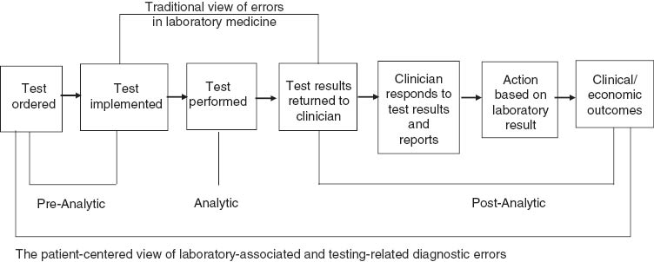
Total Testing Process
Plebani, Diagnosis 2014; 1(1): 89–94

Slide 19
What are the Challenges?

Slide 20
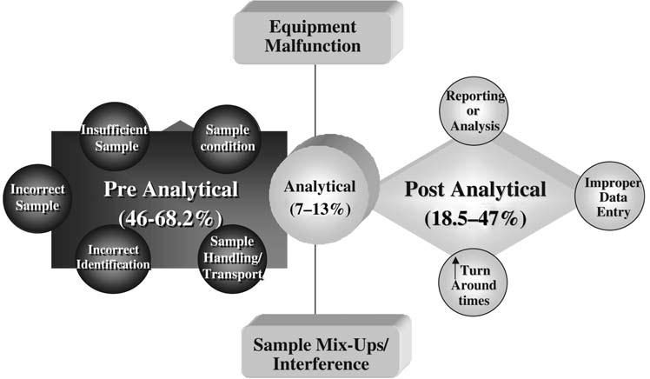
Plebani 2006

Slide 21
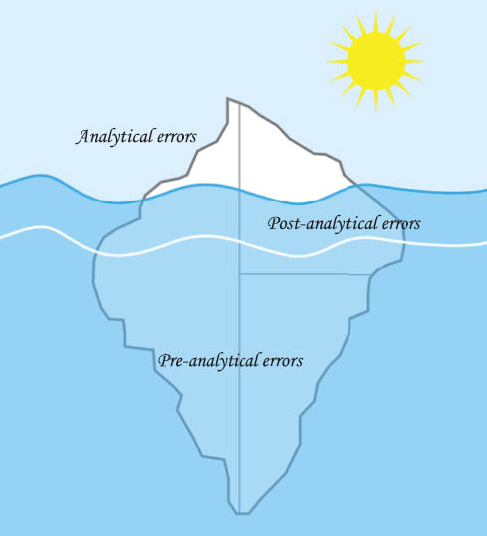
Most errors are not in the analytical phase
The Iceberg of Laboratory Errors
Clinical Chemistry and Laboratory Medicine (CCLM). Volume 53, Issue 3, Pages 357–370, ISSN (Online) 1437-4331, ISSN (Print) 1434-6621, DOI: 10.1515/cclm-2014-1051, December 2014

Slide 22


Analytical errors
Sample mix up
Inappropriate tests carried out
Diagnostic tests performed incorrectly
Automation failure
Mis-identification of the intended organism
Report the contaminant(s)
Test system not calibrated
Reagents prepared incorrectly,
stored inappropriately or
used after expiry date
Equipment malfunction
Notes:
.

Slide 23
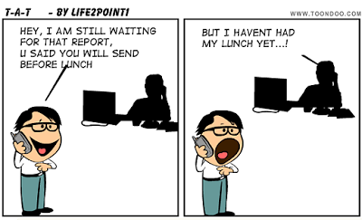
Post analytical errors
Post analytical data entry error— transcription error
Turn around times- date results entered onto the web
Clinician or other provider fails to retrieve test result – non return
Failure to communicate critical value
Provider misinterprets lab result
Misinterpretation of results by requester
Oral miscommunication of results
Notes:
23

Slide 24
Cognitive errors
A smaller percentage of errors are due to the lack of knowledge
A Galactomannan (GM) index of 0.6
What does that mean? Is it a true positive? Does one repeat the test? Ask for a repeat? Report this result as significant?
Report on the heavy isolation of Burkholderia cepacia in a post caesarean wound swab
Report as pathogen?
Consult standard microbiology investigations
Check clinical details/history provided

Slide 25


Non-cognitive errors
Due to interruption or lapse in a normally automatic task
can be exacerbated by
Distractions
Fatigue
Stress
Interruptions

Slide 26
Impact of laboratory errors
(on post post-analytical phase)
Mismanagement of patient
Misdiagnosis
Incorrect/inappropriate treatment
Lack of treatment
Delay in treatment
24-30% of laboratory errors have affect on patient care, 3-12% cause potential or actual patient harm
Plebani 2010, Hawkins 2012

Slide 27






It’s not just about the Quality of the test
Right Result
Right Time
Right Place
Right Outcome
Right Person
Right Sample
Right Assay
A UK NEQAS Pre & Post Analytical Quality Monitoring Service
Copyright: UK NEQAS©

Slide 28
PREPQ: End to End Quality
Provides a baseline of data against which users are able to benchmark their performance
Web based service
Submit nº of quality failures vs nº of opportunities for failure in a given time period
Data is analysed according to whether the participating site numbers tests by request or by specimen
Email prepq@ukneqas.org.uk

Slide 29
EQA Process
Organising laboratory
Participants
Prepare samples
Examine samples
Analyse results
Report results
Prepare report
Evaluate
Notes:
29

Slide 30
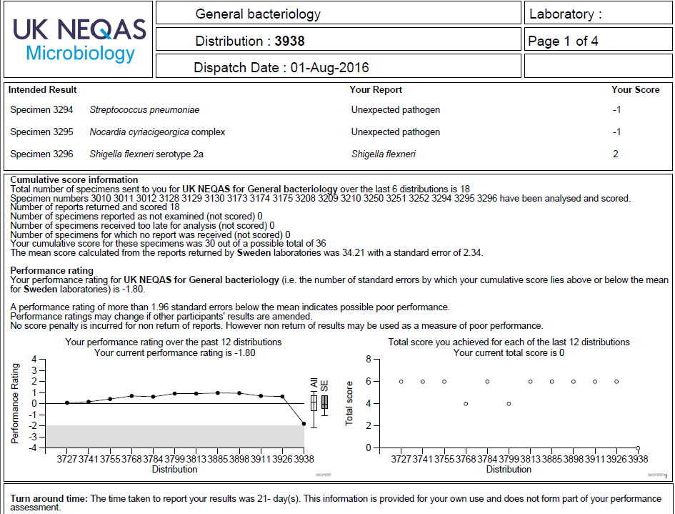
Report form for General Bacteriology
Performance rating
Cumulative scoring
Turnaround time

Slide 31
Methods in identification: bacteriology
There has been an evolution in the methods used in identification of micro- organisms in diagnostic clinical samples.
Methods selected by participants depend on the organism being identified.
Conventional methods rarely used in busy clinical microbiological settings demanding a high TAT

Slide 32
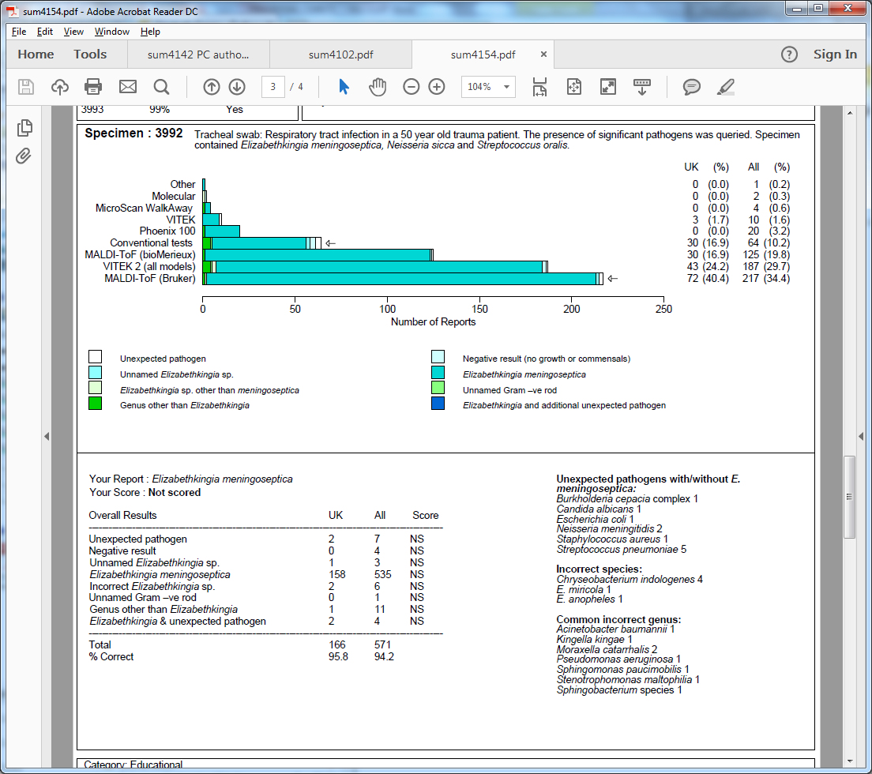
Method capture Bacteriology

Slide 33
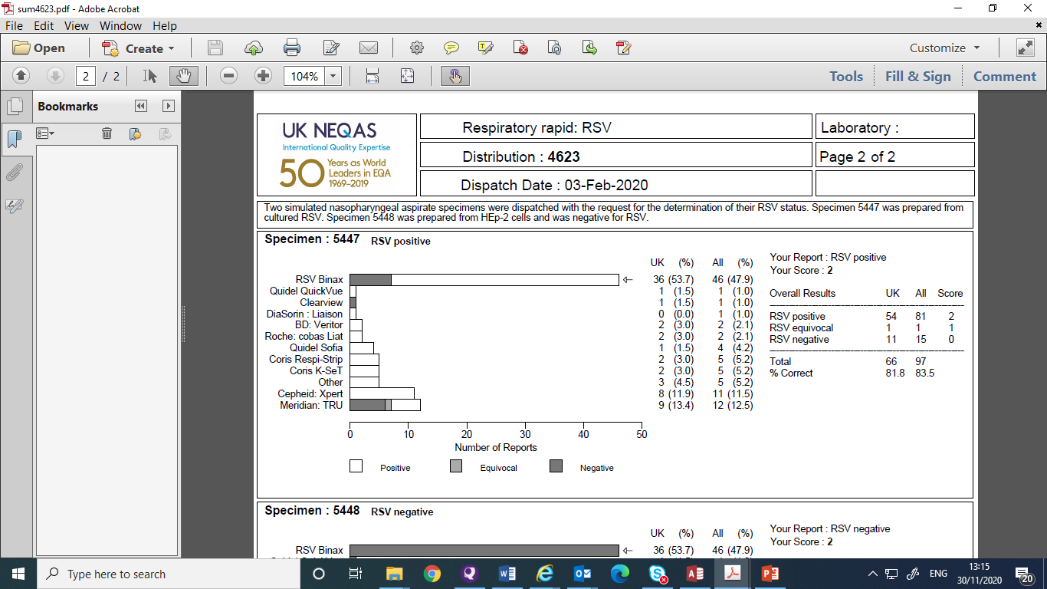
Method capture Molecular Virology

Slide 34
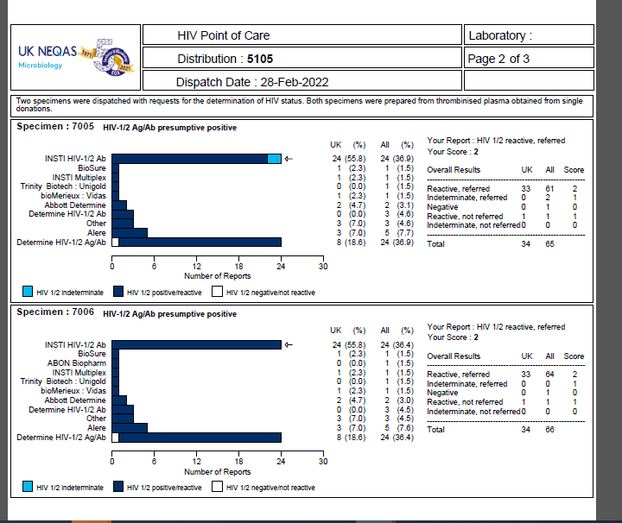
Method capture Molecular Virology

Slide 35
Streptococcus mutans: in bacteriology scheme

Slide 36
TAT: General bacteriology scheme 2019

Slide 37
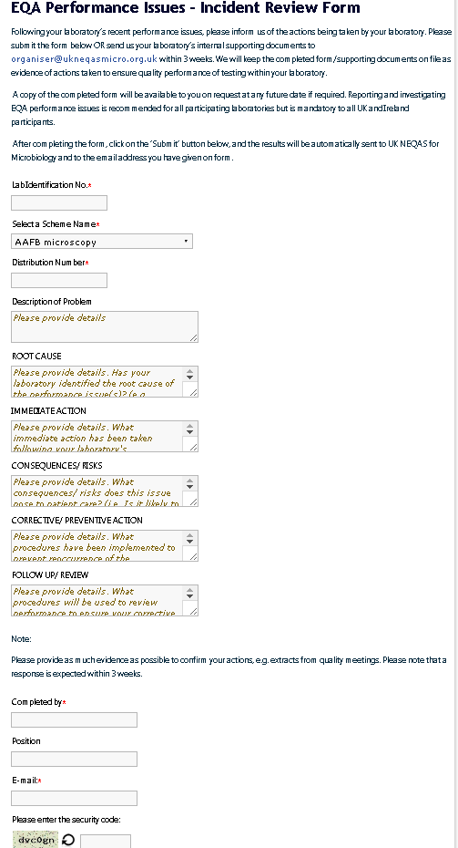
EQA Performance Issues - Incident Review Form
Lab Identification No.
Scheme Name
Distribution Number
Description of Problem
ROOT CAUSE
IMMEDIATE ACTION
CONSEQUENCES/ RISKS
CORRECTIVE/ PREVENTIVE ACTION
FOLLOW UP/ REVIEW
Completed by
Position
E-mail

Slide 38
Interpretive comments EQA
Established 2009
Defined scope & eligibility
Reports to Microbiology Steering Committee
Microbiology Scenarios
Focused on
  pre-analytical
  post-analytical
  clinical management
Encourages reflective learning
Promotes patient safety
Supports appraisal & revalidation
Supports laboratory accreditation
Provides assessment (as part of Education)
Identifies potential poor performance

Slide 39


Global Collaborations
WHO :
  VPD-IBD (N. meningitidis, H. influenzae, S. pneumoniae)
  CAESAR (bacterial AST)
  C. diphtheriae (ID and AST)
  Malaria (ID)
  RSV (molecular detection)
  Ukraine AMR (ID and AST)
ECDC
  GASP (N. gonorrhoeae AST)
  Legionella (Legionella spp)
  EARS-Net (bacterial AST)

Slide 40
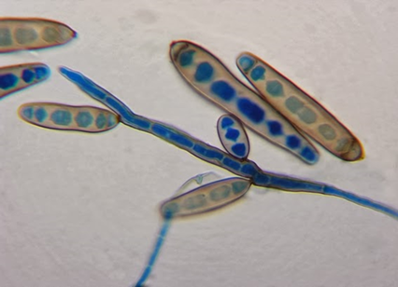
Educational
Distribute organisms that are not usually encountered or infrequently in routine diagnostic laboratories
Candida norvegensis
Bacteriodes fragilis group (MZ resistant)
Exserohilum rostratum
Cutibacterium acnes

Slide 41
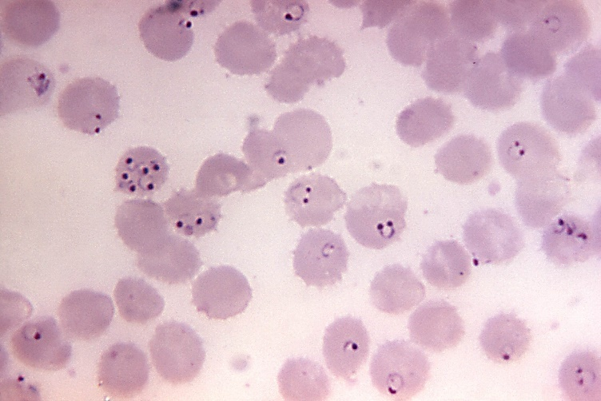
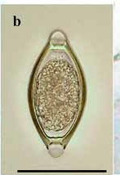
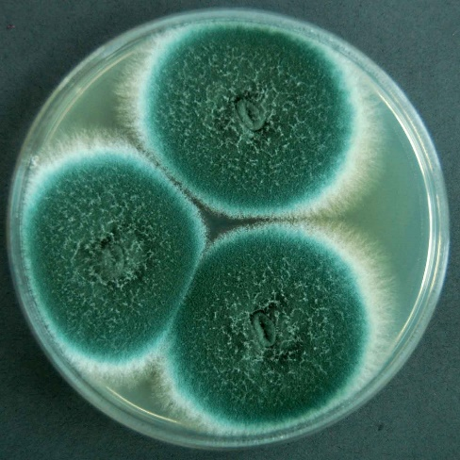
Educational: teaching workshops
Faecal Parasitology
Blood parasitology
Mycology workshop:

Slide 42
R&D
CPO scheme
Molecular detection of SARS CoV 2
Molecular detection of Respiratory viruses
In the pipeline
GBS screening
GI pathogens syndromic approach
Helicobacter pylori antigen detection
Beta D glucan antigen detection

Slide 44
Summary
Schemes satisfying these criteria are associated with improved between-laboratory comparability, both overall and in individual participating laboratories.
Full and regular participation in appropriate external quality assessment schemes is therefore established as a necessary and integral part of the rational provision of a reliable clinical laboratory service .
EQA should not be punitive: should be viewed as educational and used as a tool to help direct improvement efforts in the laboratory.
Is one of the critical elements of a laboratory quality management system.
Is a system for objectively checking the laboratory’s performance using an external agency or facility.
All laboratories should participate in an EQA process for all tests performed, whenever possible.
Accredited laboratories are required to participate in EQA.
There are several methods for conducting EQA; traditional proficiency testing is
available for many tests, is cost-effective, and provides useful information.
Where no EQA/PT other methods should be employed.
There must be no difference in the treatment of a proficiency testing sample and a
patient sample.
Normal testing methods must be followed and the procedure must involve personnel who routinely perform the testing.
Ongoing monitoring of EQA performance using an accredited EQA scheme will help to reduce laboratory errors, produce accurate patient test results and most importantly improve patient care.

Slide 45

Recommended sources for info
www.ukneqas.org.uk
www.ukneqasmicro.org.uk
Quality Assurance—Principles and Practices in a Microbiology Laboratory J Snell
Any queries happy to help: shila.seaton@phe.gov.uk
Thank you listening

